Slide 1
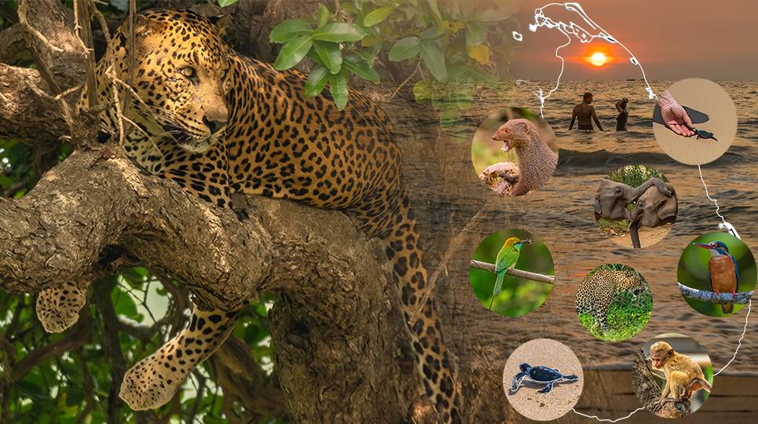
Welcome
[Title]
[Learner Name]
[Course Name]

Slide 2
Agenda
List the main areas you will cover in your project presentation.
Reason for selecting Sri Lanka for this project.
Questions to be answered
Repurposing publicly available dataset for the project.
Exploratory analysis in Sri Lankan tourisms
Tourist demographics and interests
Popularity among tourists and locals
Key stakeholders (e.g., tour operators, photographers, conservation organizations)
Overview of wildlife species

Slide 3
The Problem Statement
In 2-3 sentences introduce your Problem Statement and how your plans to solve the problem.
Is there significant demand for photography in Sri Lanka?
To determine the demand for photography in Sri Lanka, I plan to analyze data from various sources, including online search trends, social media engagement, and bookings for wildlife photography tours2. By examining these metrics, I can identify patterns and trends that indicate interest and demand. Additionally, I will survey potential customers to gather insights on their preferences and willingness to participate in wildlife photography tours. This data-driven approach will help me tailor my offerings to meet the market demand effectively.

Slide 4
Hypothesis
Discuss the Hypothesis you have for the solution and what is fuelling this hypothesis. If there is no such hypothesis, then why not?
"There is a significant demand for wildlife photography in Sri Lanka due to its rich biodiversity and unique wildlife, attracting both professional and amateur photographers from around the world.
Did you come across any previous problems similar to yours and what were the solutions to these similar problems?

Slide 5
Data and Tools Used
Where did you find the dataset?
Did you have to join multiple datasets in order to create the ideal dataset?
What other data would you have liked to have in an ideal scenario?
Which tools did you use to undertake the processing and statistical analysis?

Slide 6
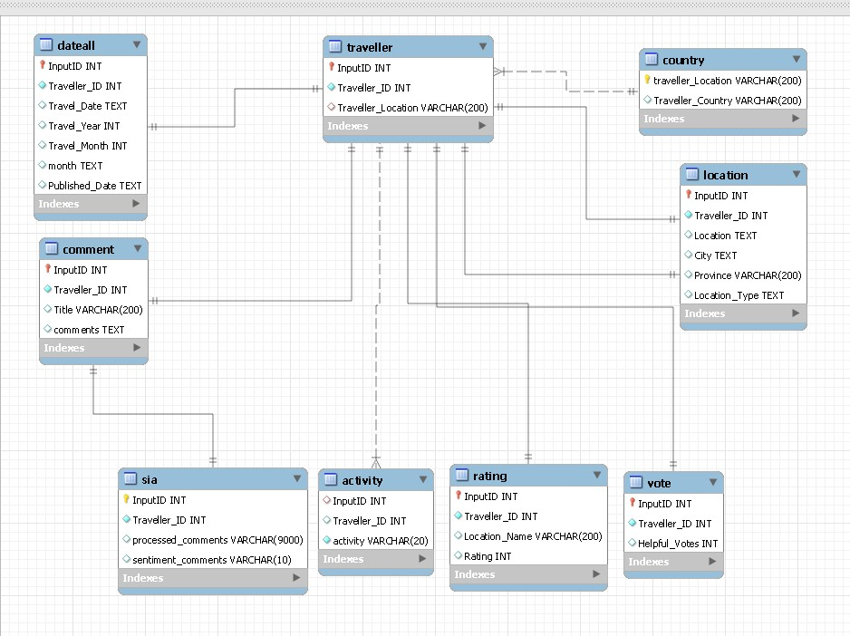




ELT
Reviews.CSV
Country Mapper
Sentiment analysis

Slide 7
Data Processing
What did you do to refine your data: outline your process.
Outliers. How did you determine outliers in your dataset? What thresholds did you set? Did you have to make any additional assumptions?

Slide 8
Data Processing
Were there any surprising insights from your data processing/exploration?
Plots showing these insights? These can be visuals exported from Tableau.

Slide 9
Statistical Analysis
An overview of the different statistical analyses performed, and why they were chosen.
Note: Feel free to make multiple slides to discuss each one in more detail.

Slide 10
Insights Discussion
What were the main insights from the Statistical Analyses
Note: Using visuals to discuss these would be ideal. These can be visuals exported from Tableau

Slide 11
Summary Conclusions
Was your expected Hypothesis confirmed or not?
Did the problem get solved from your analysis?
If not, then where do you think the issue happened.
Note: A Hypothesis not getting confirmed is not a failure. It is a scientific method of improving understanding. Be comfortable with negative results as they are just as important in informing decisions!

Slide 12
Key Learnings
What would you change in this project process if you could do this all over again?

Slide 13
Thank You

Slide 14
Appendix

Slide 15
References
References for the entire workflow can go here or in Speaker Notes per slide.

